Slide 1

GIT Version control system by using AWS

Slide 2



AGENDA
Creating ec2 instances
Create repo in local machine
Creating repo in remote location
Working with remote repo
Creating new branch from main branch
Pushing a locally created repo to github
Pull all branches in your local machine
Merge our feature branch with main branch
Go to local machine
Topic two
Topic three
Topic four
Topic five

Slide 3




GIT
git is version control system for tracking changes in computer file and is used to help coordinate work among several people on a project while tracking progress overtime. In other words it is tool that facilitates source code management in software development

Slide 4

PROJECT-1
GIT-vcs by using aws

Slide 5
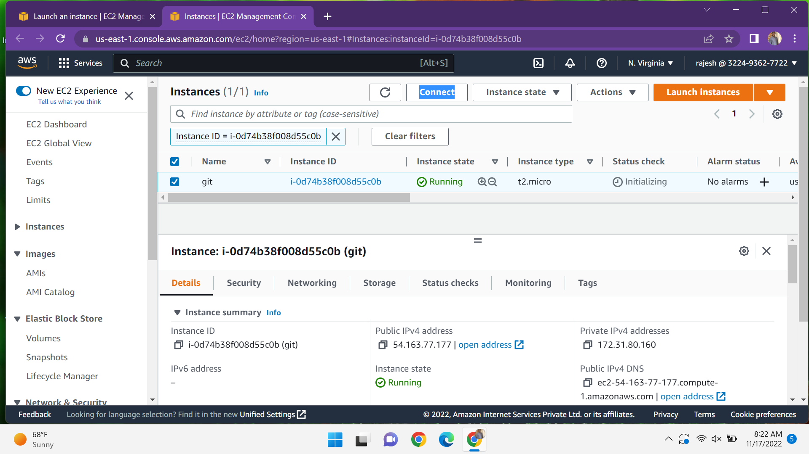
Scenario-1
Login into your aws console and create a server with linux and connect the server to the terminal by using the keypair

Slide 6
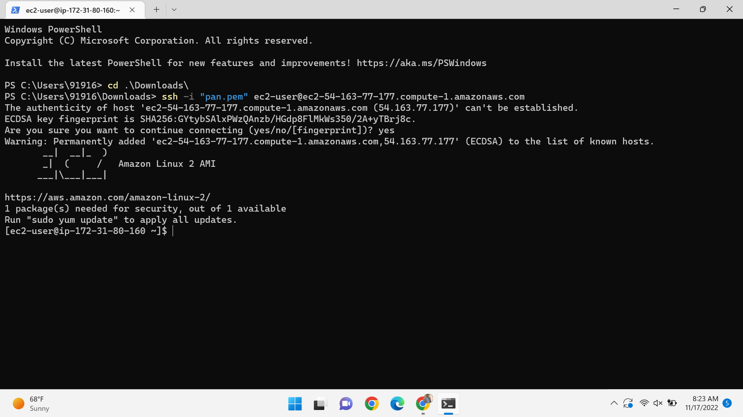
Connect the server to the terminal

Slide 7
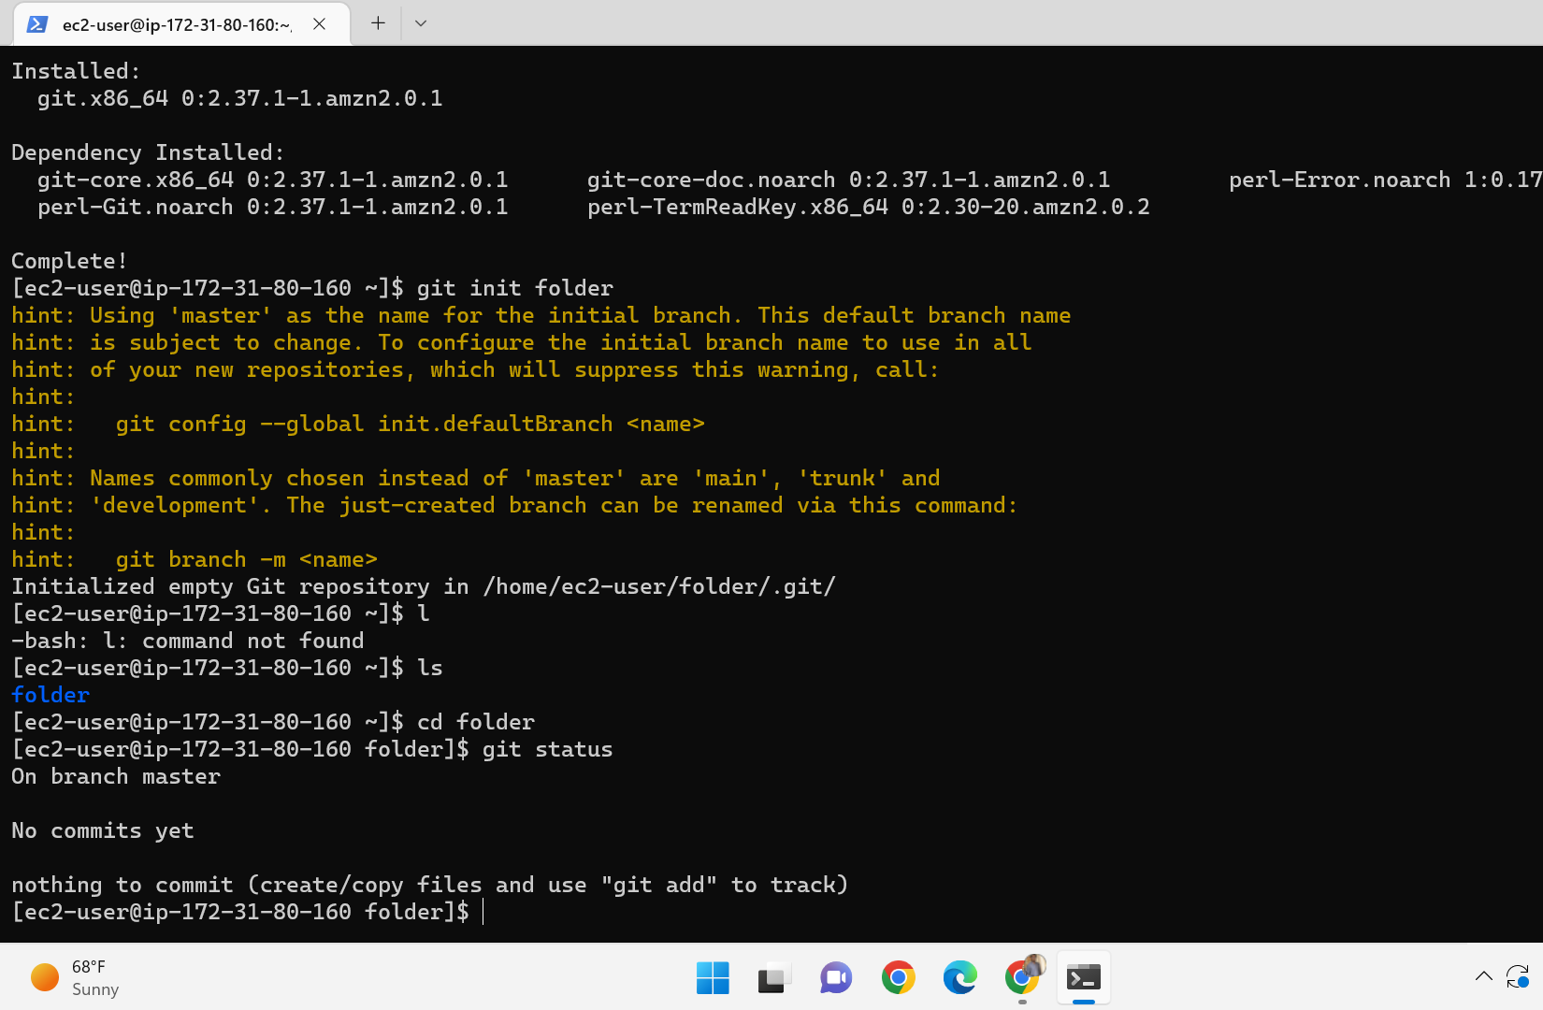
Scenario-2(create repo in local machine)
Create a folder in the local repo using the git init command and after go to that folder create one empty file , see the status and it shows a file present and untracked by git and then add the file git add and git commit the file.

Slide 8
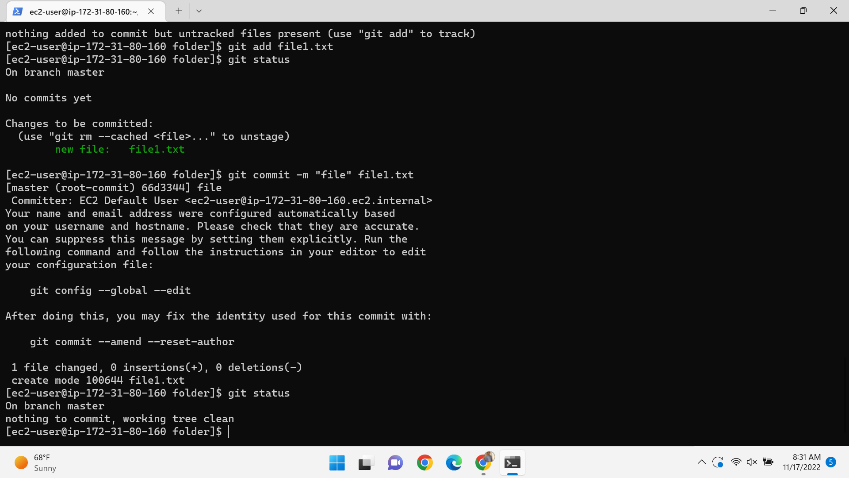
After git commit and again see the status it shows working tree clean

Slide 9
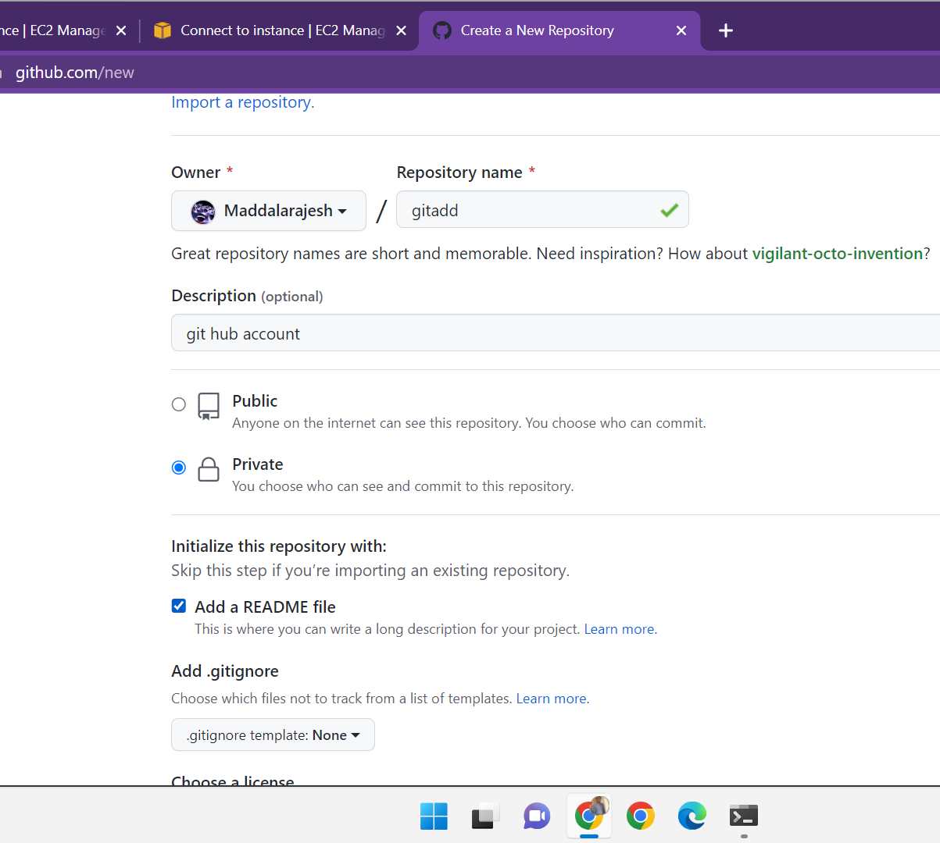
Scenario-3 (create repo in remote location)
Go to your git hub account create a new repo by click on new give a name for repo and the git account is private after add the README file and click on create repo.

Slide 10
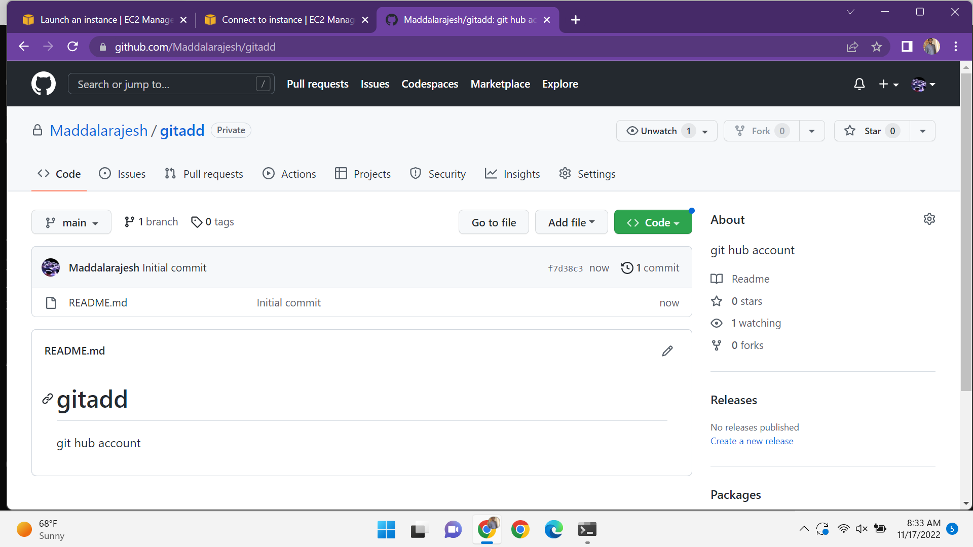
Your remote repo

Slide 11
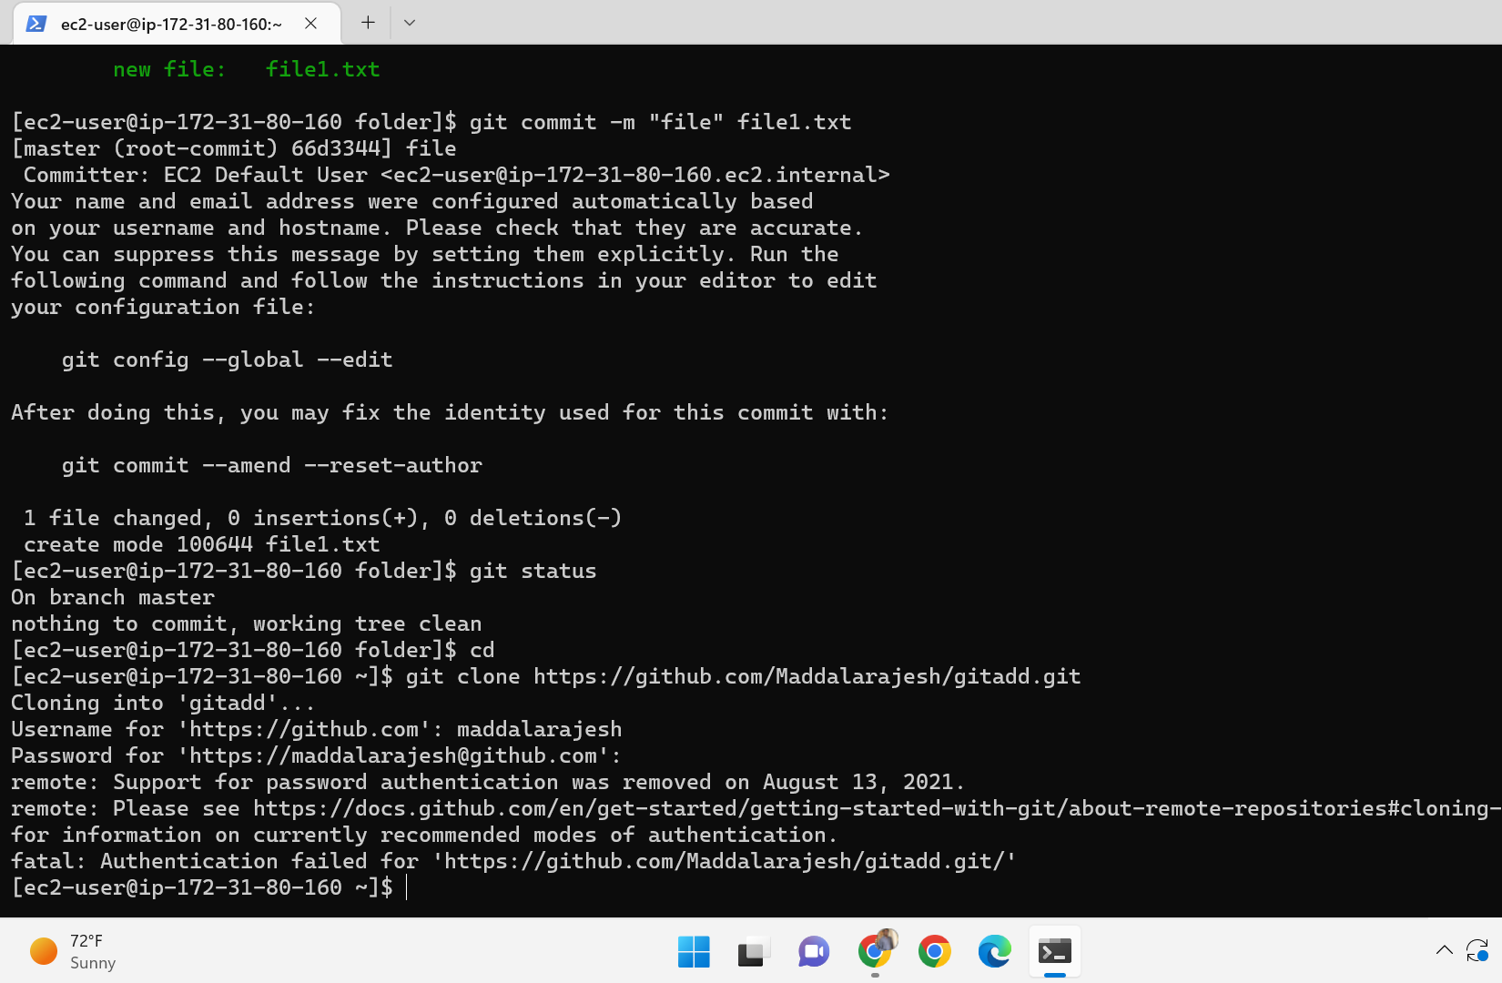
Scenario-4(working with remote repo)
Go to your local machine clone the code and it ask a password and the username . Give the user name and password it does not works because the password does not works create personal access key and after create a file in local repo add the file from local to staging area using the command git add and after add staging area to remote area give a command git command –m and git push after go to remote see the file is present

Slide 12
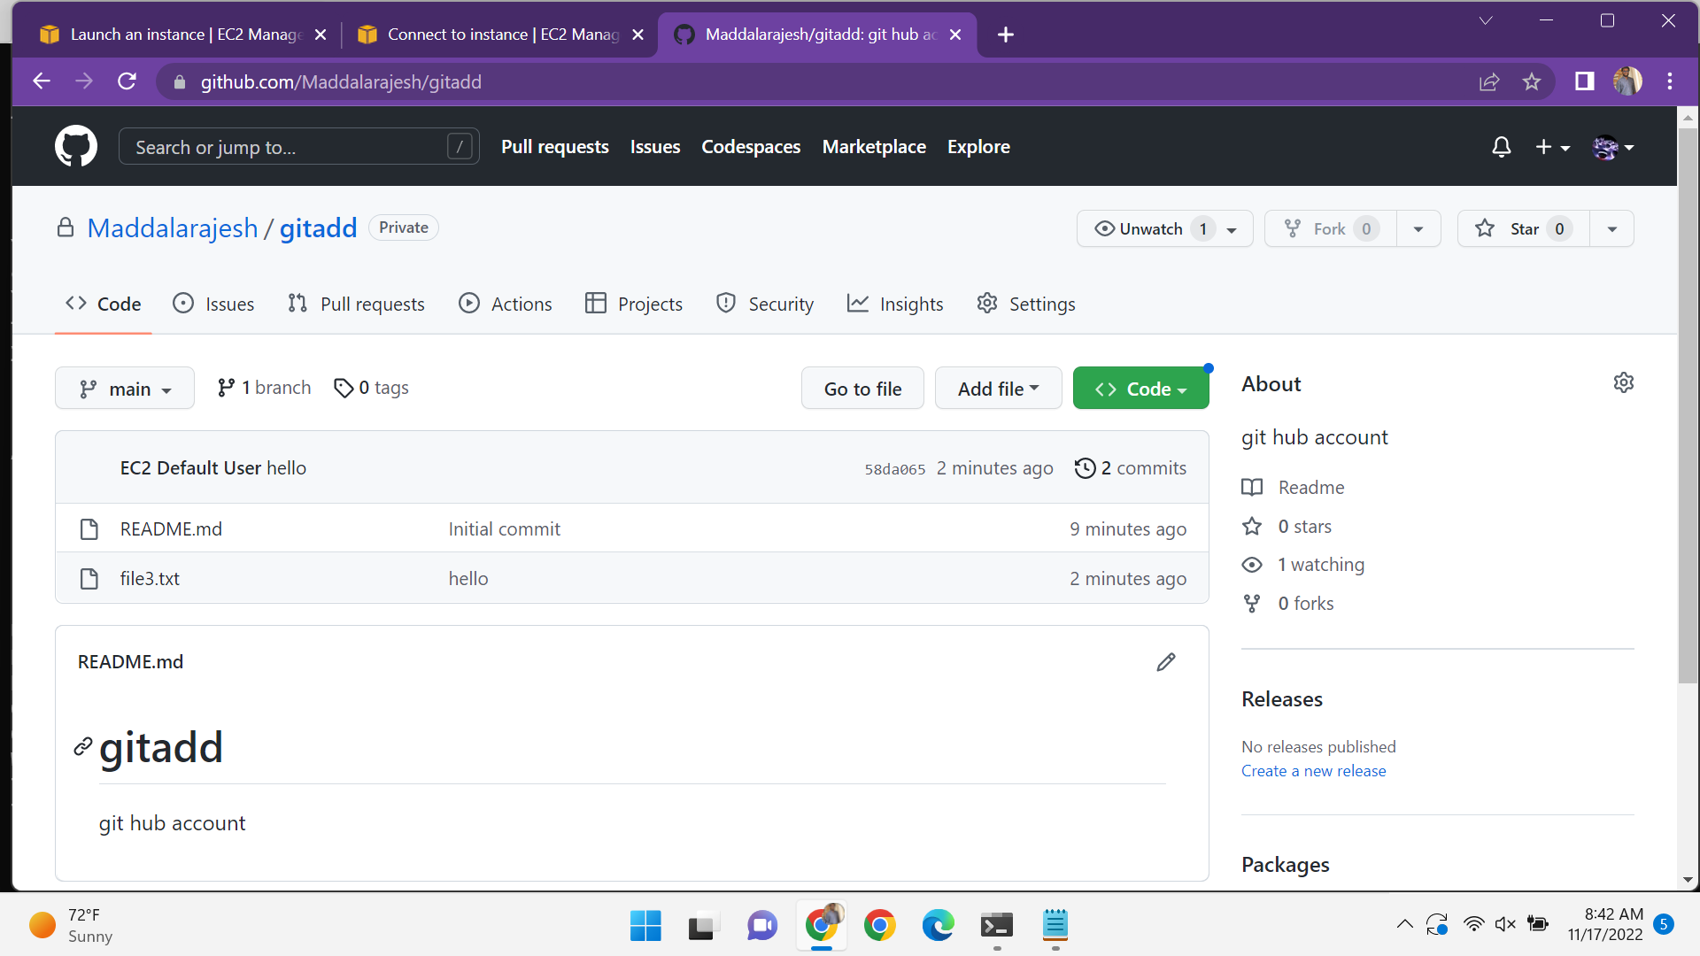
Your file is present in remote repo

Slide 13
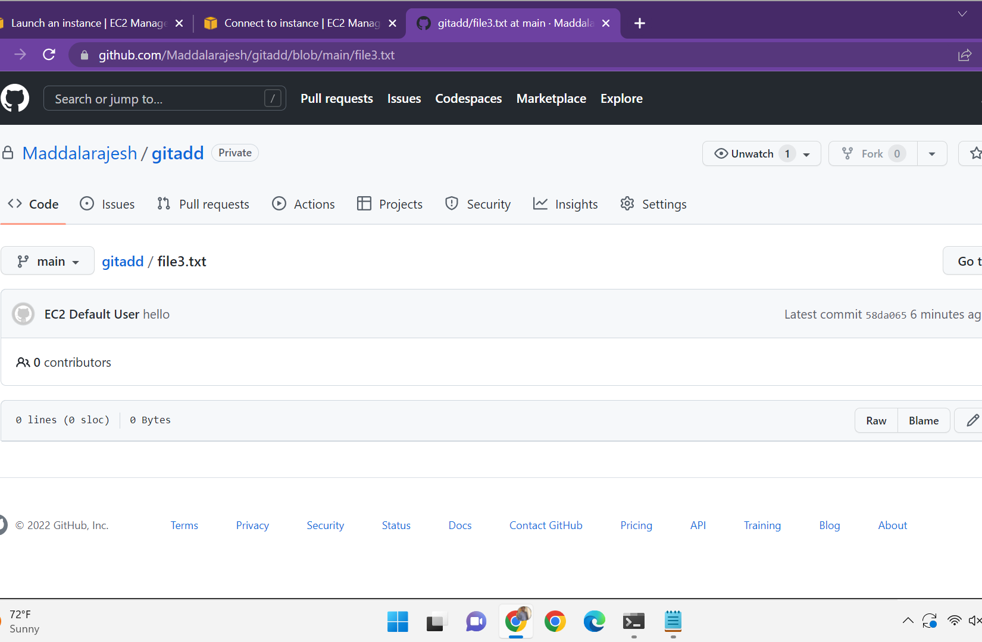
Scenario-5(creating a new branch from your main branch)
Go to our remote repo click on main create a new branch from main and click on create it can be created after creation of branch make some changes in the branch and switch to main there is no change in main.

Slide 14
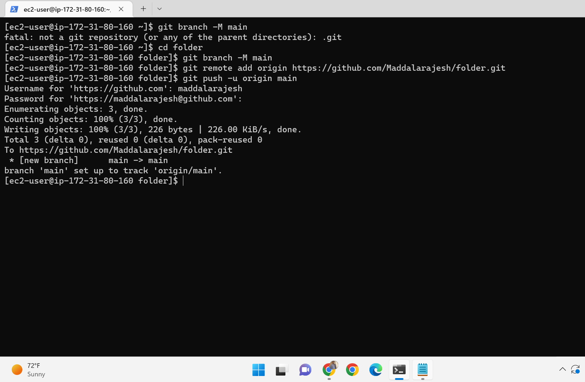
Scenario-6(pushing a locally created repo to github)
Go to github repo create a repo with same name with local repo and it cannot be initialize it and come to your local repo give the commands.
Git branch –M main
Git remote add origin (paste URL)
Git push –u origin main

Slide 15
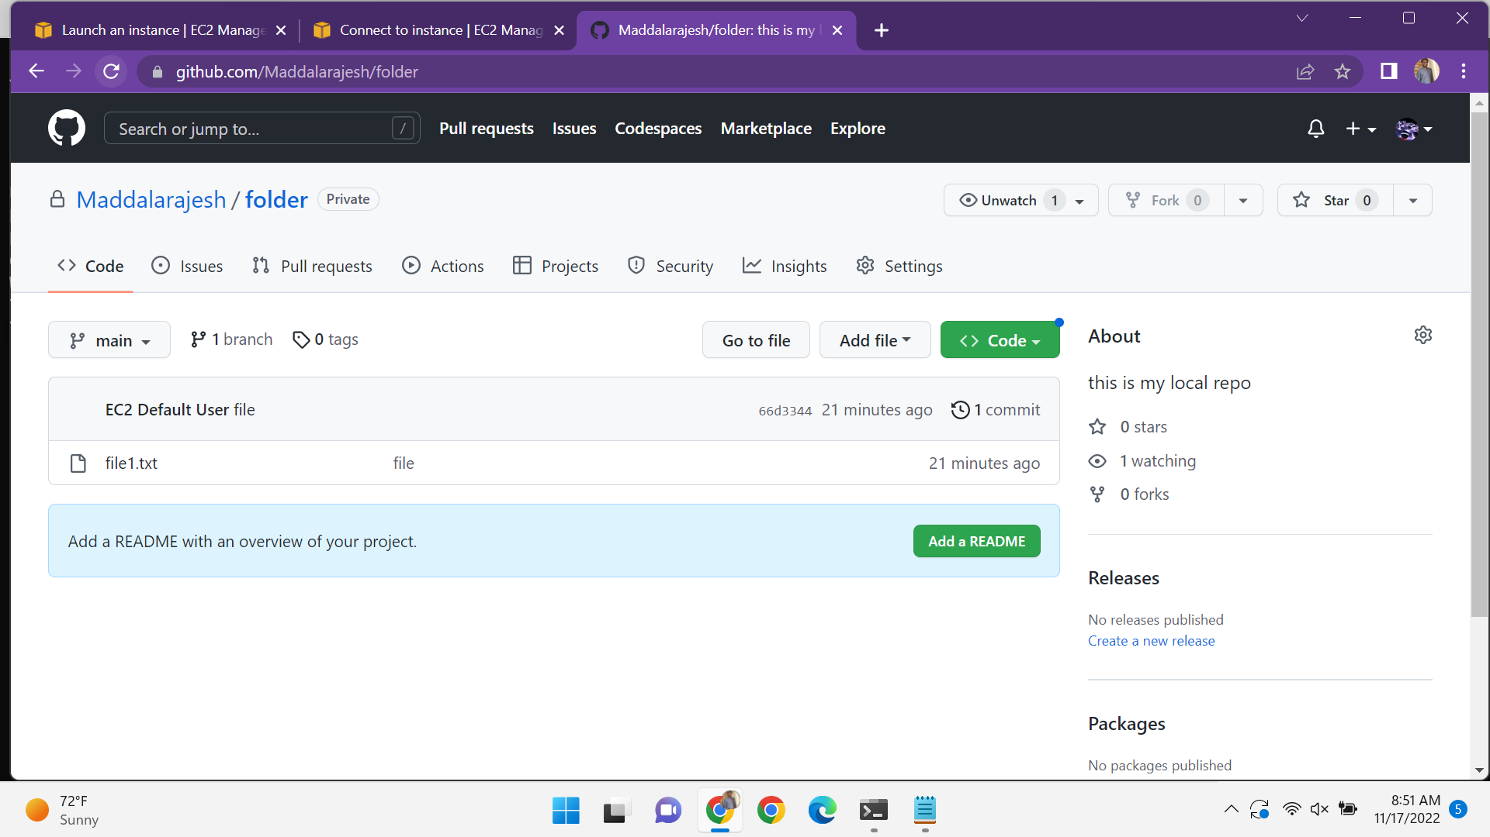
Now your local repo in present in github

Slide 16
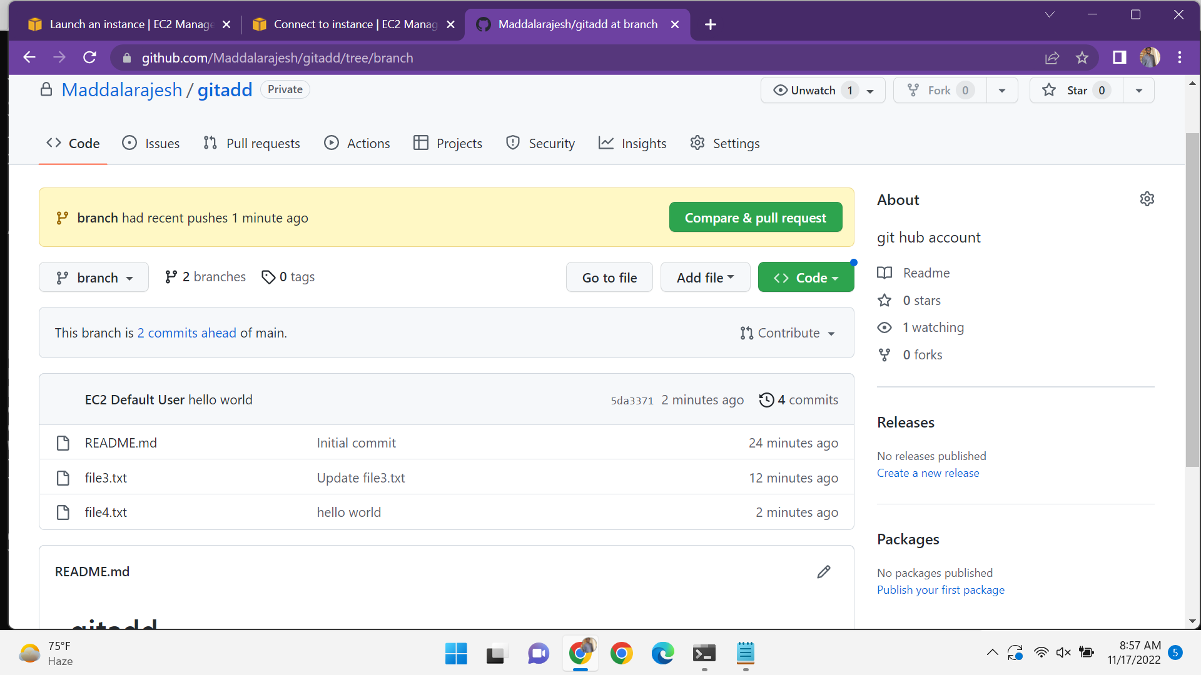
Scenario-7(pull all the branches in your local machine)
Go to your local machine run the git pull command and git branch –a and checkout the feature –git checkout branch. And see the status and create a files , the files are add to local repo to staging area and staging to remote repo and git push command is used to push the remote repo tp central repo go to the github account and see the changes.the new changes only in branch but not in main.

Slide 17
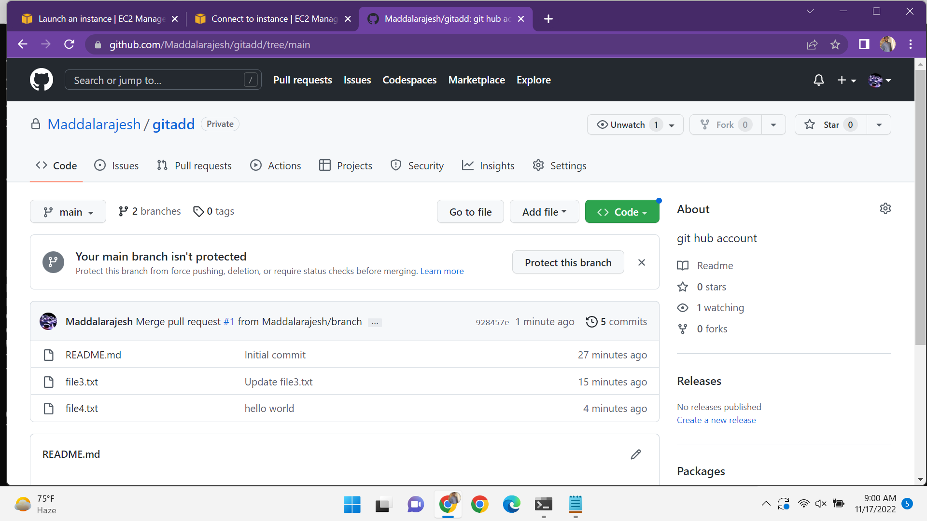
Scenario-8(merge our feature branch with main branch)
Go to git hub repo click on create and pull request and commit changes and click on confirm merge and it shows it is merged. And now the changes can be in main.

Slide 18
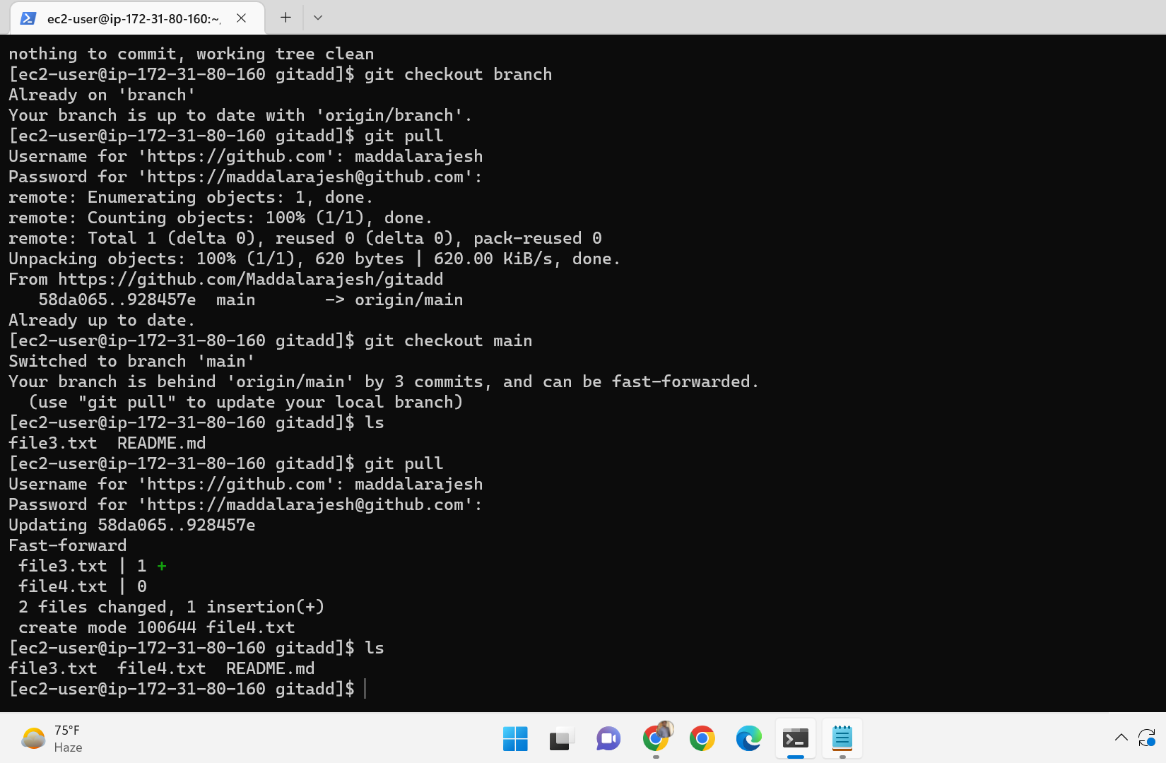
Scenario-9(go to local machine)
Go to your local machine and checkout from branch to main. And run the git pull command . the all changes in local repo also see.

Slide 19

Summary
Finally git is a tool. We can do any changes in the code and all the changes can be recorded by version control system.

Slide 20


Thank You
Rajesh maddala
maddalarajesh78@gmail.com

